Slide 1
Pongal Know Your Numbers
START

Slide 2
How many pots are there ?
2
4
3

Slide 3
CORRECT
There are 3 pots!
NEXT

Slide 4
Oops! Please Try Again
TRY AGAIN

Slide 5
How many sugarcanes are there ?
7
6
5

Slide 6
CORRECT
There are 6 sugarcanes!
NEXT

Slide 7
Oops! Please Try Again
TRY AGAIN

Slide 8
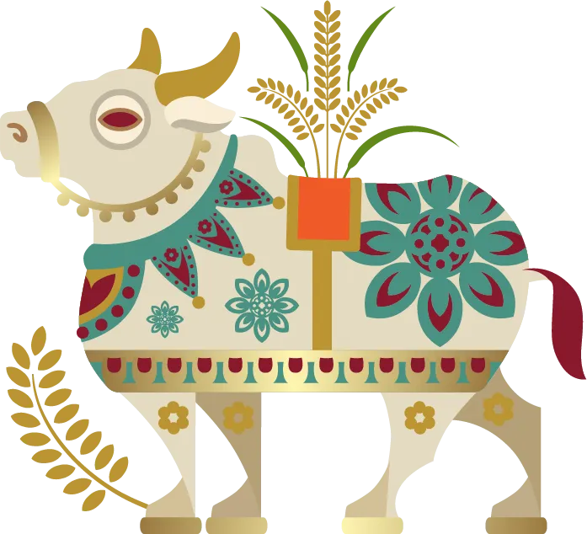
How many cows are there ?
5
3
4

Slide 9
CORRECT
There are 4 cows!
NEXT

Slide 10
Oops! Please Try Again
TRY AGAIN

Slide 11
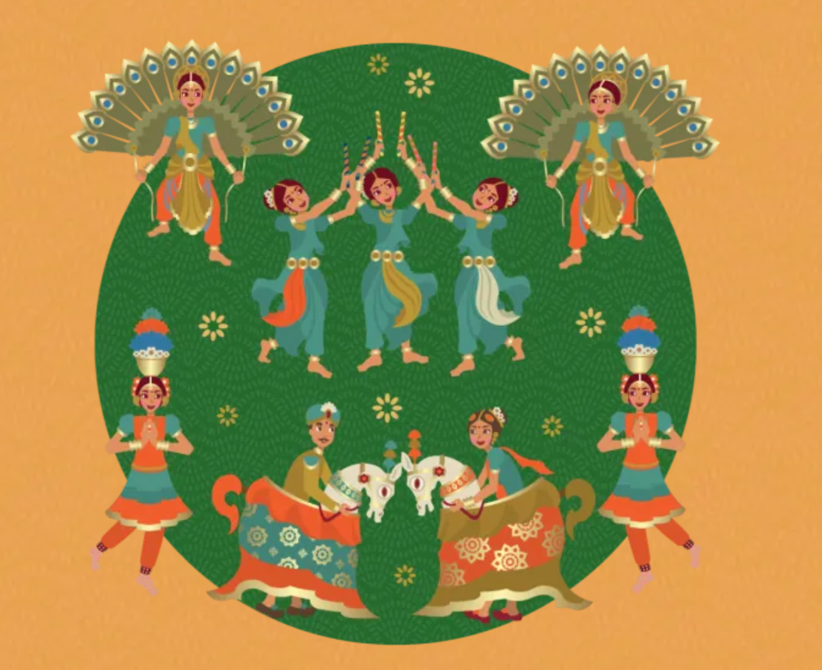
How many dancers are there ?
7
9
8

Slide 12
CORRECT
There are 9 dancers!

Slide 13
Oops! Please Try Again
TRY AGAIN

