Slide 1
Pongal Match Pictures to Word
START

Slide 2
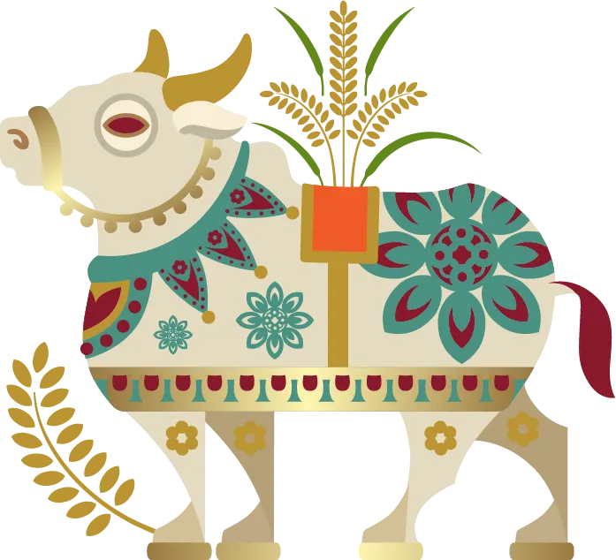
What is this ?
Bull
Cow
Ox

Slide 3

CORRECT!
This is a COW
NEXT

Slide 4
Oops! Please Try Again
Try Again

Slide 5

What is this ?
Moon
Star
Sun

Slide 6

CORRECT!
This is a SUN
NEXT

Slide 7
Oops! Please Try Again
Try Again

Slide 8

What is this ?
Pot
Bowl
Cup

Slide 9
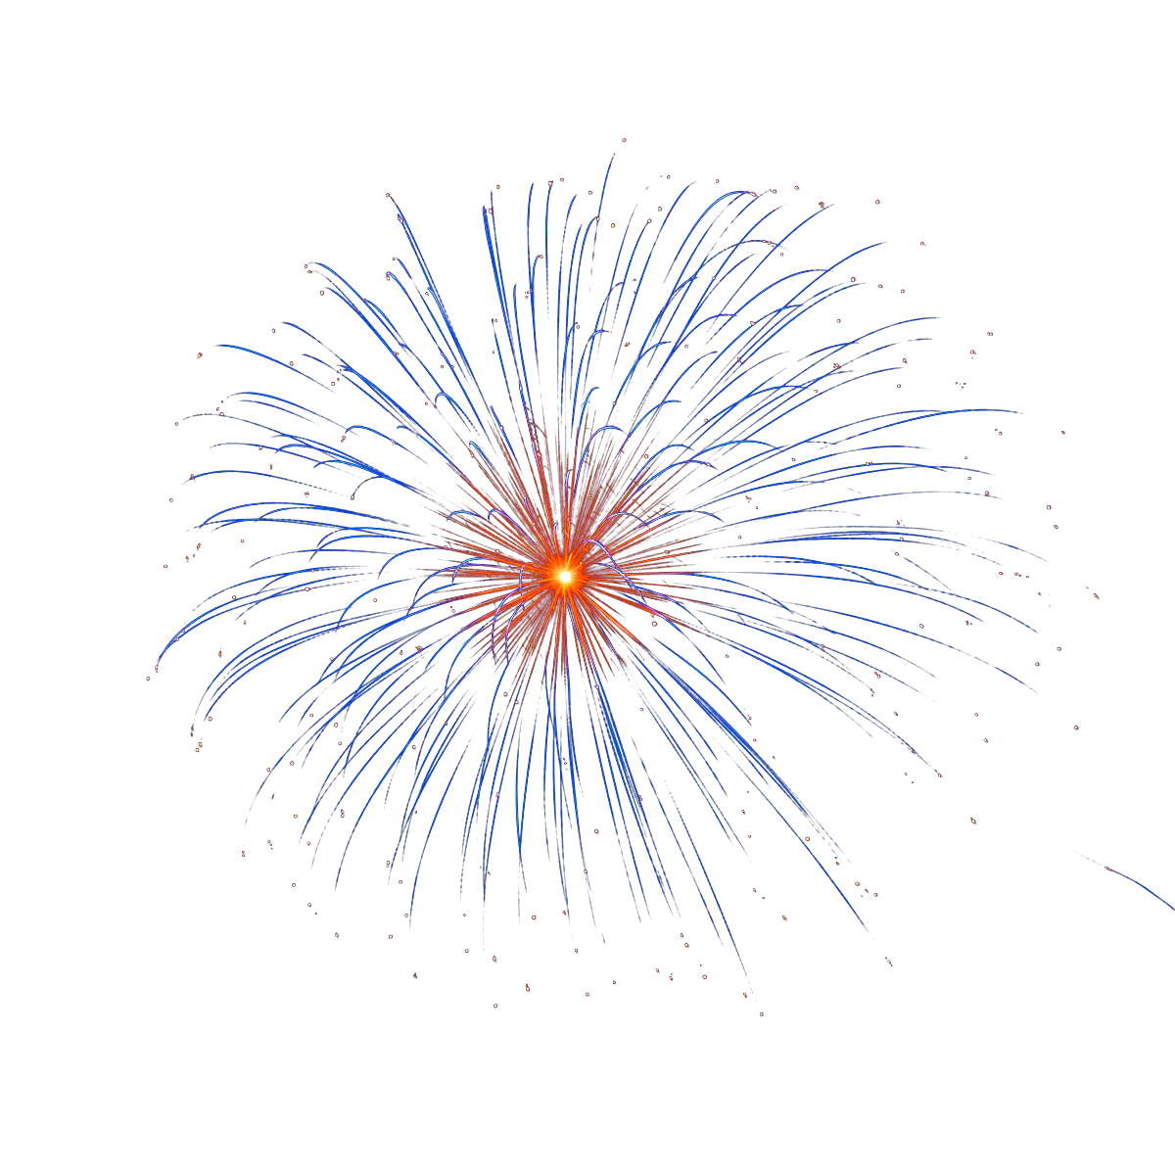
CORRECT!
This is a POT
NEXT

Slide 10
Oops! Please Try Again
Try Again

